Slide 1
Business Economics: Topic 3
Marcelo Ortiz M.
Department of Economics and Business
Universitat Pompeu Fabra

Slide 2
Topic 3: Coordination through Contracts
Objectives
1) understand the firm as a set of contracts
2) identify important owner-manager conflicts
3) understand how contracts can reduce or solve the conflicts
4) differentiate between moral hazard and adverse selection
5) list the components of agency costs
6) identify implicit contracts
7) list the three components of a firm’s organizational architecture

Slide 3
The concept of the firm as a focal point for a set of contracts
So far we have seen that markets use prices to allocate resources while firms use managers. We also have discussed the relative efficiency of markets and firms
When doing this, we assume that firms have just one central manager who aims to maximize the firm’s value
In this topic:
1) we remove this (unrealistic) assumption
2) is the firm as efficient as the markets to internally allocate resources? If not, how can we reduce the inefficiencies?

Slide 4
The concept of the firm as a focal point for a set of contracts
How does the allocation of resources take place within a firm?
Decisions and execution:
  Board of directors
  CEO
  Department officers
  Middle-level managers
  Rank-and-file employees

Slide 5
The concept of the firm as a focal point for a set of contracts
We need a richer definition of the firm to be able to capture such complexity
→ the firm is a focal point for a set of contracts:
  1) The firm as a creation of the legal system: it can enter a contract, be sued, and so on
  2) Focal point: the firm is always one of the parties in all the contracts that constitutes the firm
  3) Some clauses in the contracts can be explicit (legal arrangements) or implicit (traditions, culture)

Slide 6
Incentive Conflict within the firms
Economic theory characterizes individuals as creative optimizers of their own utility
Thus, the collection of individuals that contract with the firm are not likely to have objectives that are automatically aligned
The owners of the firm have title to the residual profits (what is left over after other claimants are paid) and are likely to be interested in maximizing the present value of these profits.
  But the other individuals within the firm (CEO, employees) do not share this goal necessarily.
  This situation represents an incentive conflicts

Slide 7
Incentive Conflict within the firms
Owner-manager conflicts:
Effort choice
Perquisite taking
Differential risk exposure
Differential horizons
Overinvestment

Slide 8
Incentive Conflict within the firms
Other conflicts:
Managers and lower-level employees
Creditors and shareholders (e.g., dividends)
Managers and labor union
Owners and suppliers/costumer
Even among owners! (free riding)

Slide 9
Incentive Conflict and contracts
There are mechanisms to control incentive conflicts:
  1) contracts (the focus of the course)
  2) market for corporate control
Imagine this situation: a company with a potential market value of $10 is being managed by a CEO who destroys value ($1) by using a Private Jet instead of economy flight tickets for job-related trips. Explain how each mechanism would works.

Slide 10
Incentive Conflict and contracts
Costly Contracts: contracts need to be negotiated, written, and enforced.
The main limitation of contracts for solving conflicts is that they rely on information that is costly to obtain (information asymmetry)
  In our previous example: the CEO knows better the potential value of the firm and how much he is traveling.
  How costly is it for shareholders to reduce this information asymmetry?
There are two types of information problems: before and after contracting.

Slide 11
Contractual information problems
Time
Find a
counterpart
Negotiate
contract terms
Sign the
contract
Monitor and
Enforcement

Slide 12
Precontractual information problems
1) Adverse selection: Adverse selection refers to the tendency of an individual with private information about something that affects a potential trading partner’s costs or benefits to extend an offer that would be detrimental to the trading partner.
  Example: (health insurance market) Two women of the same age and profession living in the same city. Woman A knows that her expected annual medical expenditure is $100, while Woman B knows that in her case it is $700. This information is costly to get by the Health Insurance Company.
  What happened if the company offers a health insurance with price $400 (the average). No gains from trade!
  Solutions:
    1) adverse selection can be solved by the correct design of a contract set in which the individuals can self-select based on their private information (screening contracts)
    2) It also can be solved by signaling techniques to allow the principal to infer the agent’s private information. This signal has to be costly to be effective, because other agents might want to imitate the signal to misguide the principal

Slide 13

Precontractual information problems
1.1) Self selection:
The idea of this solution is to offer different contracts in such a way that the agent (employee/customer) selects the appropriate one given its private knowledge.
Ex: how many types of contract are used by health insurance companies?
  Fixed fee, coverage, and deductible

Slide 14
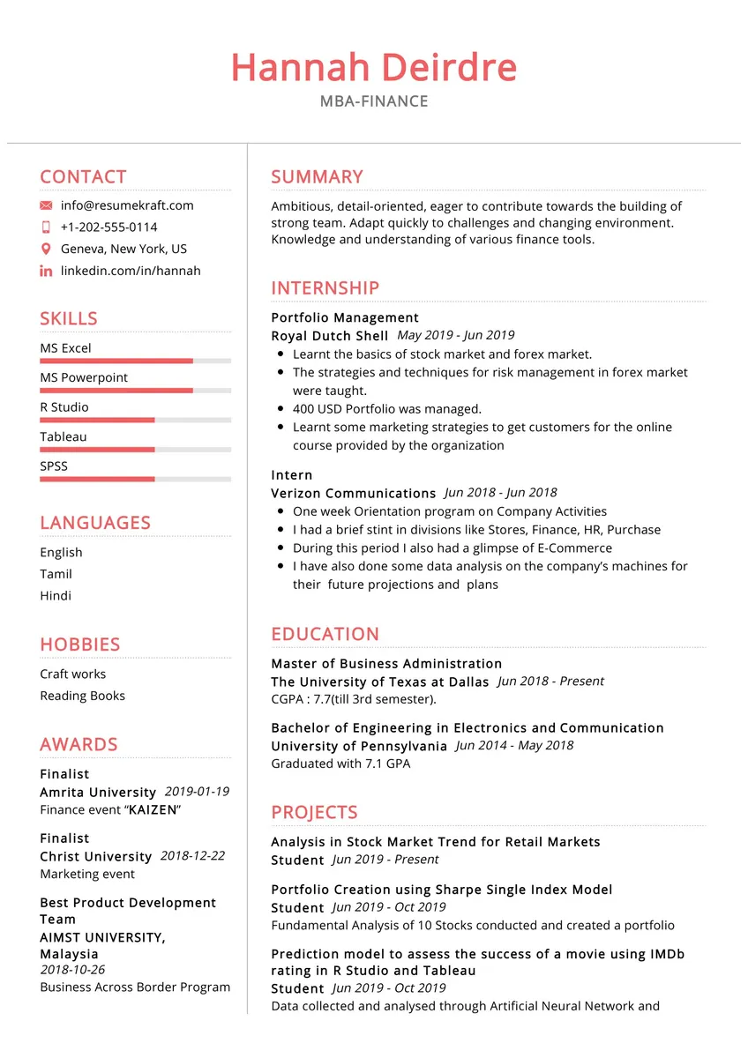
Precontractual information problems
1.2) Signaling:
The idea of this solution is that agents can provide a credible signal that allows to the principal to identify its private information.
The signal must be too costly to imitate by other agents
Example:
(1) the signaling role of education in the labor market
(2) the signaling role of an entrepreneur’s investments in his/her own business

Slide 15
Precontractual information problems
2) Bargaining Failures: parties do not reach a (mutually-beneficial) agreement by lack of the correct information
Examples:
(1) Salary talk in a job interview with a no-hiring result
(2) Managers and labor union negotiation and strikes

Slide 16
Precontractual information problems
How the parties can reduce adverse selection problems in the following cases?
  Identify the agents and nature of the trade negotiation
  Identify the costly information and who owns it (describe the information asymmetry)
  Identify the inefficiency generated by this incentive/information problem
  Describe a contract set that allows for self-selection or a credible and costly signal
1) Financing contract: a bank deciding which individuals to lend to
2) Purchase contract: a buyer deciding which second-hand car to buy

Slide 17
Postcontractual information problems
Agency problems
  An agency relationship consists of an agreement (e.g., contract) under which one party, the principal, engages another party, the agent, to perform some service on the principal’s behalf
  The agency problem: once the contract is set, the agent pursues its incentives to increase its well-being at the expense of the principal.
  Asymmetric information: the principal cannot observe the actions of the agent costlessly, so the agent can engage in detrimental activities, not being detected by the principal
    Principals can limit this behavior but must incur in monitoring costs
    Agents can also face bonding costs to provide a guarantee
  Total agency cost= out-of-the-pocket costs (monitoring and bonding cost)+ residual loss

Slide 18




Postcontractual information problems
Agency problems
Which contract/transaction suffers agency problems?
How to solve it?

Slide 19
Implicit contracts
Many (if not most) of the contract clauses that constitute a firm are implicit.
  Promises and understanding that are not formalized as legal documents
  Examples: the promise of promotion or salary raise for a job well done, dressing code for meeting clients
But if they are not legal agreements (so are not enforceable in courts) why do individuals expect others to honor them?
  Because of reputation concern acts as a driving force to motivate contract compliance
  Market participants can impose substantial costs on individuals for unscrupulous behavior
Reputation concern is a market force pushing to act with integrity
  1) employee retention
  2) suppliers relationship
  3) customer loyalty
  4) investor relations

Slide 20
Implicit contracts
The limits of this implicit contract (or reputation concern):
- the amount of information available (likelihood of cheating detection)
  - clients receiving products with subpar materials/quality. No access to inspection technology.
- the speed of information dissemination to potential trading partners
  - “Fraud and move”
  - Accelerating contracts overseas before a scandal is made public.
- the magnitude of the social/economic sanction
  - a social culture that underweights lousy behavior.

Slide 21
Incentives to reduce contracting costs
Everyone has an incentive to resolve contracting problems in the least costly manner, because in this way there are additional gains from trade to share among parties
This means that incentives exist within the contracting process to produce an efficient utilization of resources (from the perspective of the contracting parties)
The view of contracts as an efficient response to incentive problems within a firm is an extremely powerful tool in explaining observed organizational designs:
  Simple example: compare the labor contracts of fruit pickers and airplane assemblers.
  - temporal vs long term contract
  - solutions for incentive/information conflicts
  - f(k,L)??

Slide 22
Contracting costs and organizational architecture
Firm goal: producing output that customers want at the lowest possible cost in a context with:
  Uncertain demand
  Important information for economic decisions is held by different individuals
  Information is costly or impossible to transfer
  Decision-makers might not have the appropriate incentives to take the effective decisions from the firm perspective (even if they have the information needed!)
The fundamental problem in Organizational Design: how to organize an economic activity to try to achieve the objective
  This means solving or alleviating reducing contracting costs and agency conflicts

Slide 23
Contracting costs and organizational design
Organizational design: created by executives via the implicit and explicit contracts that constitute the firm and assign decision rights, performance evaluation, and compensations
  A good design reduces contracting costs and encourages desired behaviors among employees (fewer agency conflicts): each contract establishes decision rights and economic incentives.
  This design is created by executives! not the result of market transactions.
  Naturally, firm performance (and survival) depends on how efficient is this design in fostering desired behaviors.

Slide 24
Contracting costs and organizational design
Components of an organizational design:
  1)Decision rights allocation: Who does what? → How to assign decision rights among employees?
    Should employees in the logistics department have decision rights (assigned in their contracts) about product design?
    What conflicts could emerge?
  2)Incentive system (performance evaluation and compensation): how to evaluate and reward employees to mitigate incentive conflicts?
    How should product designers been evaluated?
    How their compensation should be structured? (fixed salary, performance bonus, stocks?)

Slide 25
Contracting costs and organizational design
Basic examples of different organizational architectures:
  1) CEO makes most of the major decisions despite lacking relevant information
  2) CEO attempts to acquire relevant information to make better decisions but this is costly and time-consuming
  3) CEO decentralize decision rights to individuals with better information, but this delegation leads to higher incentive problems
Once the CEO decide to delegate some decision rights to some executive, the executive then decide which decisions to make himself and which decisions delegate to a lower level manager
  Delegation and execution of decisions create space for agency conflicts.
A well-designed organization aims to minimize the agency costs across the company

Slide 26
Cases to Discuss
Present an real case related to some of the topics of the class.
  The case should be based on recent news (<2 years) and preferably related to Spanish companies/cases.
  Start the presentation with the context behind the event/decision/case, then identify the relevant concepts, to finally conclude/assess the case.
  10 min, 7-11 slides
  Examples:
    1) a CEO fired by any of the owner-manager conflicts
    2) Why do some companies offer a large variety of plans/contracts? An adverse selection explanation
    3) Agency problems when voting for a politician
    4) Reputation concern in markets platforms such as Wallapop, Amazon, Carrefour.

Slide 27
Summary
Main concepts
  Incentive conflicts
  Contracts and contracting costs
  Information asymmetry/costly
  Agency problem
  Bargaining failure
  Adverse selection
  Signaling and self selection
  Implicit contracts
  Organizational design (and its components)

